Slide 1
Lecture 1:
The .NET Architecture

Slide 2
Objectives
“Microsoft .NET is based on the .NET Framework, which consists of two major components: the Common Language Runtime (CLR) and an extensive set of Framework Class Libraries (FCL). The CLR defines a common programming model and a standard type system for cross-platform, multi-language development.”
CLR-based execution
Application designs

Slide 3
Part 1
CLR-based execution…

Slide 4
Influences
.NET is the result of many influences…
OOP
JVM
GUI
.NET
Web
component-based design
n-tier design

Slide 5
.NET is multi-language
.NET supports VB, C# (C-sharp), C++, J# (Java 1.2), Eiffel, etc.
code.vb
code.cs
code.cpp
...
FCL
Development Tools
app.exe

Slide 6
.NET is cross-platform
Compiled .NET apps run on any supported platform:
APP.exe
?
Win64
Win32
(XP,2K,98)
WinCE
Notes:
Other platforms? As of May 2003:
Mono: open-source Linux port of .Net, beta, no GUI support.
Rotor: MS has released the source to the standardized components of .Net, compiles on Windows, FreeBSD, and Mac OS X. 1.0 Release, C# only, no GUI support.
Mono can be downloaded from http://www.go-mono.com/
Rotor, officially known as SSCLI, can be downloaded from http://msdn.microsoft.com/net/sscli

Slide 7
How is cross-platform achieved?
Cross-platform execution realized in two ways:
  apps are written against Framework Class Library (FCL), not underlying OS
  compilers generate generic assembly language which must be executed by the Common Language Runtime (CLR)

Slide 8
(1) FCL
Framework Class Library
  1000's of predefined classes
  common subset across all platforms & languages
  networking, database access, XML processing, GUI, Web, etc.
Goal?
  FCL is a portable operating system

Slide 9
(2) CLR-based execution
Common Language Runtime must be present to execute code:
APP.exe
OS Process
CLR
JIT Compiler
other FCL components
Core FCL
obj code
Underlying OS and HW
Notes:
JIT = Just-in-time, which gets its name because you generate the actual x86 code at the last possible moment, i.e. run-time.
Java uses same approach with its JVM

Slide 10
Implications of .NET's execution model
Clients need CLR & FCL to run .NET apps
  available via Redistributable .NET Framework
  20MB download
  runs on 98 and above, NT (sp6a) and above
Design trade-off…
  managed execution (memory protection, verifiable code, etc.)
  portability:
  slower execution?

Slide 11
Part 2
Application design…

Slide 12
Monolithic
Monolithic app: all source code compiled into one .EXE
  *not* the norm on Windows…
APP.exe

Slide 13
Component-based
Component-based app: .EXE + 1 or more .DLLs
  standard practice on Windows…
GUI.exe
compute.dll
data.dll

Slide 14
Why component-based?
Many motivations:
  team programming
  multi-language development (I like VB, you like C#)
  code reuse (e.g. across different .EXEs)
  independent updating (update just component X)
FCL ships as a set of components!

Slide 15
Assemblies
.NET packages components into assemblies
1 assembly = 1 or more compiled classes
  .EXE represents an assembly with classes + Main program
  .DLL represents an assembly with classes
code.vb
code.vb
code.cs
Development Tools
.EXE / .DLL
assembly

Slide 16
CLR-based execution revisted
CLR must be able to locate all assemblies:
.DLL
.EXE
.DLL
.DLL
OS Process
CLR
JIT Compiler
other FCL assemblies
Core FCL
assembly
obj code
obj code
obj code
obj code
Underlying OS and HW
Notes:
CLR = Common Language Runtime
FCL = .NET Framework Class Library

Slide 17
Assembly resolution
How does CLR find assemblies?
For now, simple answer is sufficient:
  our DLLs must reside in same directory as our EXE
  FCL assemblies reside in GAC
  CLR looks in GAC first, then EXE's directory…

Slide 18
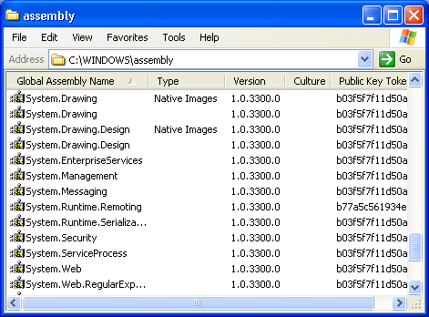
GAC?
GAC = Global Assembly Cache
  C:\Windows or C:\WinNT directory
Observations:
  explorer yields a flat view of GAC
  command-shell yields actual representation
  GAC can hold different versions of the same assembly
  some assemblies have been pre-JIT ("native image")
  tamper proof via digital signatures…

Slide 19
Summary
.NET architecture is:
  multi-language
  cross-platform
  based on the CLR, FCL, and JIT technology
Application designs are typically multi-tier
Application designs yield component-based development
  .NET components are packaged as assemblies

Slide 20
Resources
Books:
  J. Richter, "Applied Microsoft .NET Framework Programming" (C#)
  J. Richter and F. Balena, "Applied Microsoft .NET Framework Programming in Microsoft Visual Basic .NET" (VB)
  T. Thai and H. Lam, ".NET Framework Essentials"
Web sites:
  http://msdn.microsoft.com/net
  http://www.gotdotnet.com/
  Linux port (Mono): http://www.go-mono.com/
  MS source (Rotor / SSCLI): http://msdn.microsoft.com/net/sscli

